Slide 1
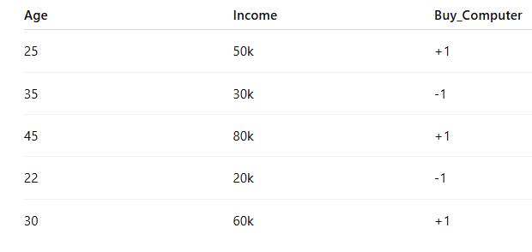
Example-1

Slide 2
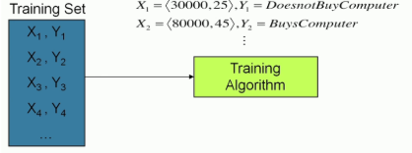
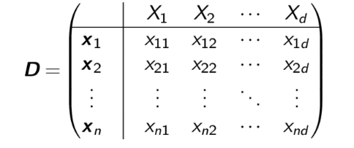
X1in the training set=
Map (Xi,Yi) onto the Data Matrix D

Slide 3
Example-1(II)
age | income | food_cost | tip_paid
24 | 30000 | 450 | 50
35 | 55000 | 1200 | 120
42 | 72000 | 980 | 90
29 | 40000 | 600 | 60
50 | 90000 | 1500 | 200
38 | 65000 | 850 | 85
27 | 32000 | 500 | 30
33 | 47000 | 700 | 70
45 | 80000 | 1100 | 100
48 | 88000 | 1300 | 180

Slide 4
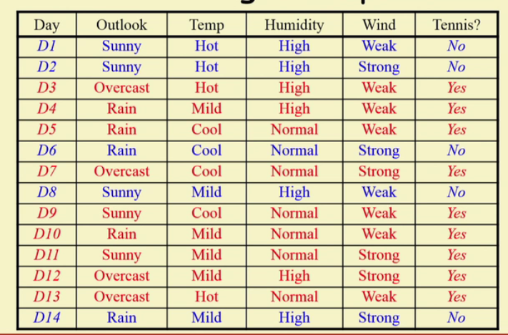
Example-2

Slide 5
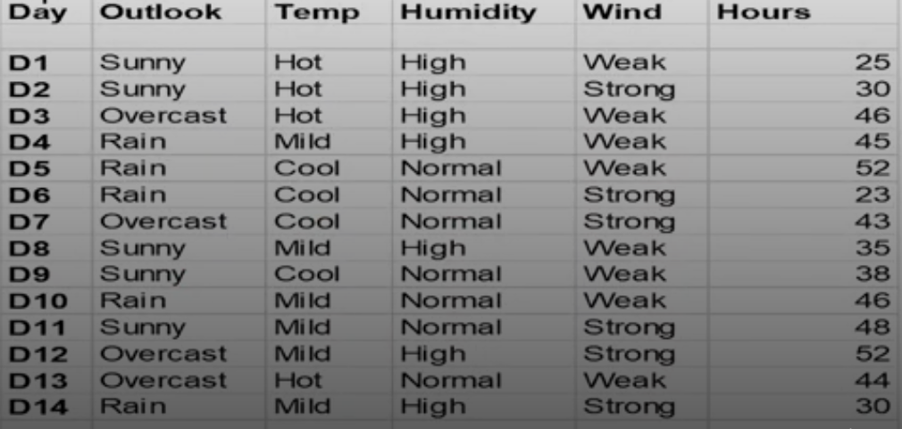
Example-3

Slide 6
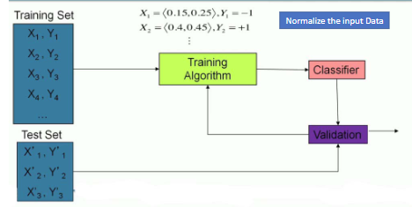

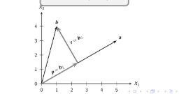
How the SL model can be mapped onto the Orthogonal Projection b onto a?

Slide 7
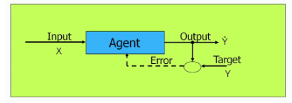
What is approximation and what is error in the diagram
How approximation and error is related to this diagram?

Slide 8
Other questions
What is Churning in relation to dataset ?
How to group the points in unsupervised Learning?

